Slide 1
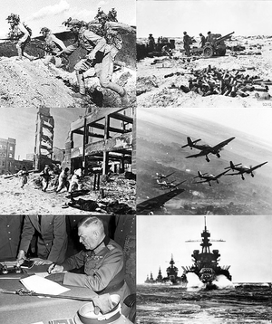

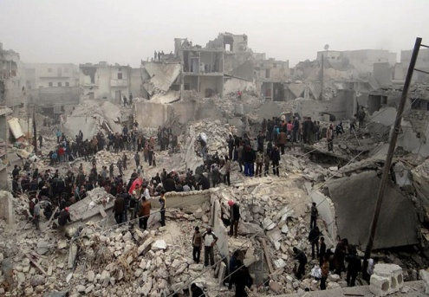

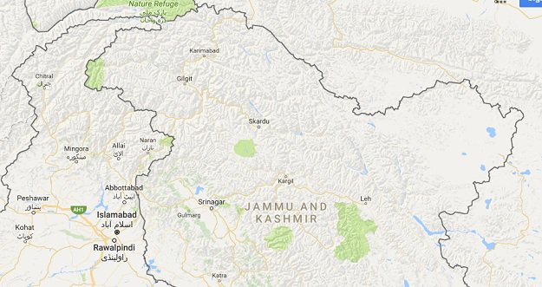


Conflict and Peace
We hate conflicts
A new movement
To spread peace
Beaconhouse
Bahria Town
Group Project
As being Global Perspectives students, we are trying our best to spread awareness among people about conflicts and peace
Conflicts are a part of the human race which are more increased with increase in number of countries gaining nuclear power. Now a days, almost half of the world is ready for clash.
The Syrian Conflict due to which millions of people has lost their lives. A conflict is also going on in Afghanistan. Similarly, Palestine has been a victim of war for long and has suffered a lot. North Korea too entered the phase of conflicts and aggression. Almost every part of the world is unsafe now. If we talk about our own country Pakistan, many crimes are going on in Peshawar and Karachi which although now
a days are bit controlled.
Merciless killing is also goi- ng on in Kashmir by Indian forces and human sufferin- gs are on their peak. There are many other examples of conflicts going all over the world and in Pakistan which cause adverse effects.
spread awareness among people about the conflicts we are facing and how to get rid from them. Please join us in this movement and contribute in peace making Thank you!.
Visit our website:
bbtscglobalperspectives.home.blog
Also join us on:
The reasons of these confli-
cts include religious, politic-
al and social matters. Many organizations such as the United Nations are working hard to spread peace. We as Global Perspectives stud-
ents are trying our best to
www.facebook.com/bbtscglobalperspectives/
Two World Wars had taken place causing great deaths. Everyone is worried of the consequences of World War Three which looks near. Many conflicts are also going now a days as well such as:
www.instagram.com/conflict_and_peace
twitter.com/bbtsc_gp
Composed by:
Ahmed Iftikhar
Husbaan Zahid
Hassan Kamran

